Slide 1
Environmental physiology
Prof. dr. Zoran Valić
Department of Physiology
University of Split School of Medicine

Slide 2
Aviation, High Altitude, and Space Physiology

Slide 3
Effects:
low gas pressures
acceleratory forces
weightlessness

Slide 4
Effects of Low Oxygen Pressure on the Body
with the increase in altitude there is decrease in barometric pressure
at sea level:
p=760 mmHg (101.3 kPa)
at 50,000 feet (15240m):
p=87 mmHg (11.6 kPa)

Slide 5
Alveolar Po₂ at Different Elevations
excretion of CO₂ and vaporization of water – dilution of the O₂ in the alveoli
water vapor pressure (at 37ºC) = 47 mm Hg (6,3 kPa, regardless of altitude)
P_{CO2} falls (from the sea-level value of 40 mm Hg (5,3 kPa)) – acclimatization (to 7 mm Hg (0,9 kPa))

Slide 6
our exercise

Slide 7
nasa vježba

Slide 8
Saturation of Hemoglobin with Oxygen at Different Altitudes
up to 10,000 feet – at least as high as 90%

Slide 9
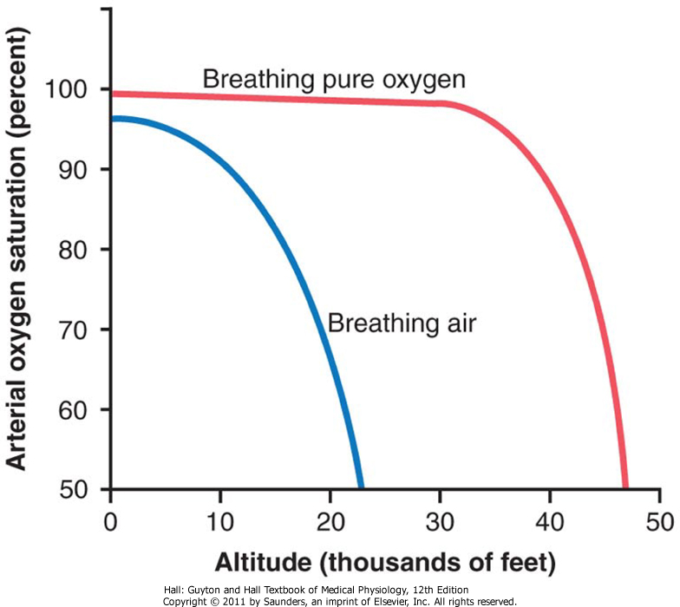

Slide 11
Effect of Breathing Pure Oxygen
39,000 feet (12000m) – at least 90%,
47,000 feet (14000m) – 50%
important for pilots (airtight plane!)
person usually can remain conscious until the arterial oxygen saturation falls to 50 percent

Slide 13
Acute Effects of Hypoxia
12,000 feet: drowsiness, lassitude, mental and muscle fatigue, sometimes headache, occasionally nausea and euphoria
18,000 feet: twitching or seizures
23,000 feet (unacclimatized): coma, death
most important: decreased mental proficiency (judgment, memory), and performance of discrete motor movements

Slide 14
Acclimatization to Low Po₂
great  in pulmonary ventilation
⇧ numbers of red blood cells
⇧ D_{LCO}
⇧ vascularity of the peripheral tissues
⇧ ability of the tissue cells to use oxygen despite low Po₂

Slide 15
Increased Pulmonary Ventilation
⇩ P_{O2} ⇨ stimulation of arterial chemoreceptors ⇨  alveolar ventilation (1.65x; in acclimatized 5x)
⇧ alveolar ventilation ⇨  P_{CO2} i  pH ⇨ inhibition of brain stem respiratory center
during 2-5 days inhibition fades away –  HCO₃⁻ ( pH) in cerebrospinal fluid (kidneys)

Slide 16
Increase in RBC
hypoxia – principal stimulus for causing an increase in RBC
Ht: from 40-45 to 60
Hb: s 15 g/dL na 20 g/dL
blood volume also increases by 20-30%
up to 2 weeks – no effect, one month – ½ effect, full effect – several months

Slide 17
Increased D_{LCO}
normal D_{LCO} is about 21 ml/mm Hg/min
increase during exercise 3x
similar increase at high altitude
⇧ in pulmonary capillary blood volume
⇧ in lung air volume
⇧ in pulmonary arterial blood pressure (forces blood into upper parts of lungs)

Slide 18
Increased Tissue Capillarity
⇧ CO (30%), but with Ht decreases
⇧ numbers of systemic circulatory capillaries in the nonpulmonary tissues
especially in animals born and bred at high altitudes
in active tissues exposed to chronic hypoxia (right ventricular muscle)

Slide 19
Cellular Acclimatization
⇧ cell mitochondria and cellular oxidative enzyme systems
tissue cells of high altitude-acclimatized human beings also can use oxygen more effectively than can their sea-level counterparts

Slide 20
Acclimatization of Native Humans
many live at altitudes above 13,000 feet, some at 17,500 and at 19,000
many are born and live at these altitudes
natives are superior, since acclimatization begins in infancy :
chest size is increased, body size is decreased (VC/mass), hearts (right) are considerably larger, delivery of oxygen to the tissues is also highly facilitated

Slide 21
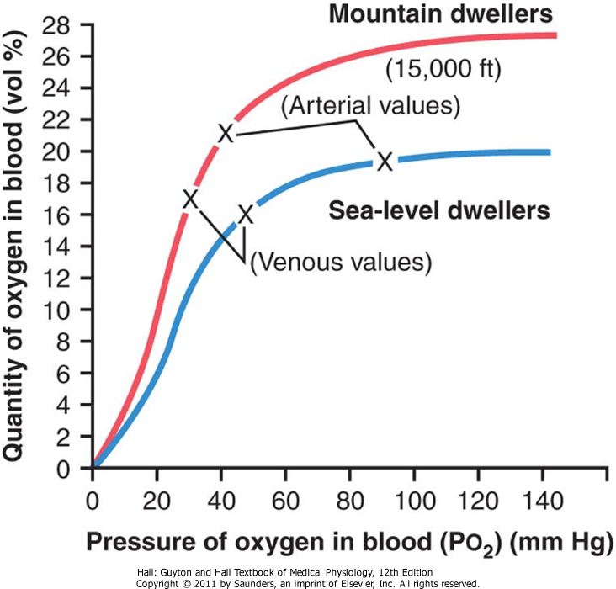

Slide 22
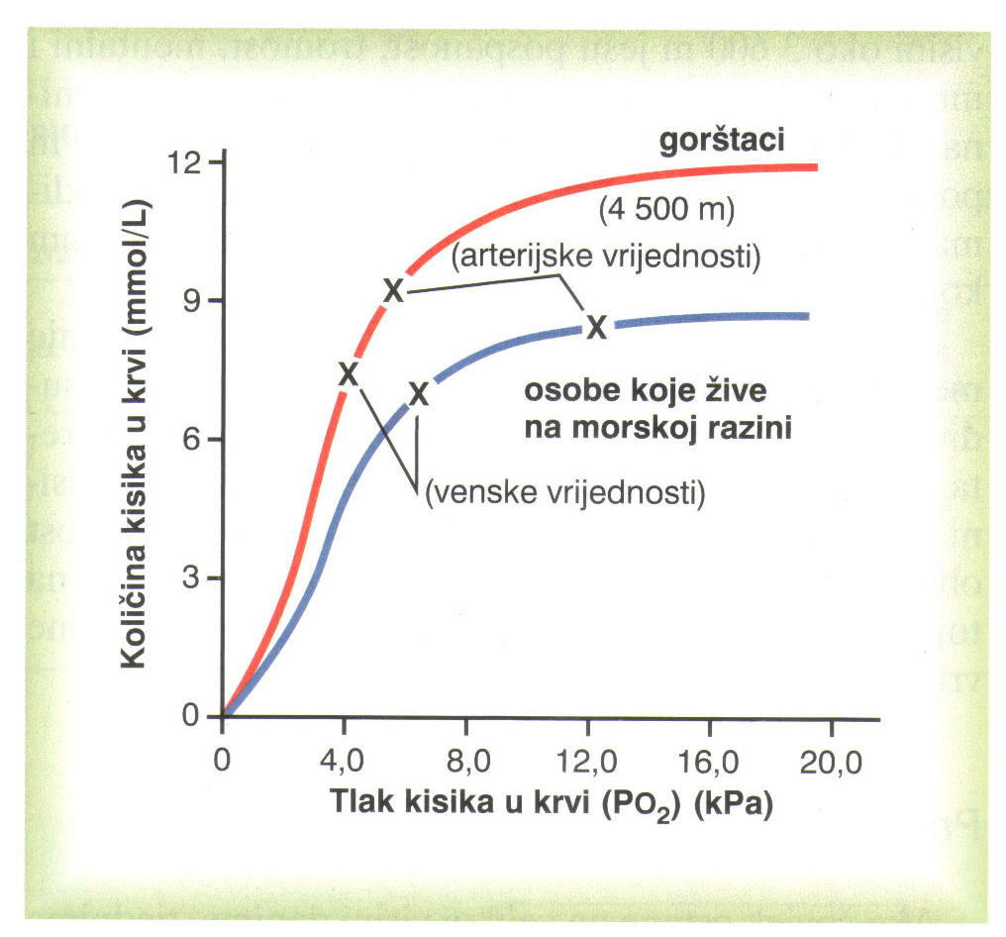

Slide 23
Work Capacity at High Altitudes
mental depression +  work capacity
not only skeletal muscles but also cardiac muscles ( CO)
naturally acclimatized native persons can achieve a daily work output even at high altitude almost equal to that of a lowlander at sea level

Slide 24
Acute Mountain Sickness
from a few hours up to 2 days after ascent:
acute cerebral edema – local vasodilation caused by the hypoxia ⇨  capillary pressure
acute pulmonary edema – hypoxia ⇨ marked vasoconstriction ⇨  capillary pressure in non constricted vessels
therapy – breathing oxygen, quick recovery

Slide 25
Chronic Mountain Sickness
⇧ RBC & Ht ⇨  viscosity &  flow
⇧ pulmonary arterial pressure
⇧ right side of the heart
⇩ peripheral arterial pressure
congestive heart failure
death
alveolar arteriolar spasm & pulmonary shunt blood flow

Slide 26
Effects of Acceleratory Forces
linear acceleration and deceleration, centrifugal acceleration (mv²/r)
positive and negative G
1G equal to body weight

Slide 27
Effects of Centrifugal Acceleratory Force
most important effect is on the circulatory system
blood is mobile and can be translocated by centrifugal forces
+G translocated into legs (+5G = 450 mm Hg) ⇨ CO
acceleration greater than 4-6 G – "blackout" unconsciousness and death

Slide 28
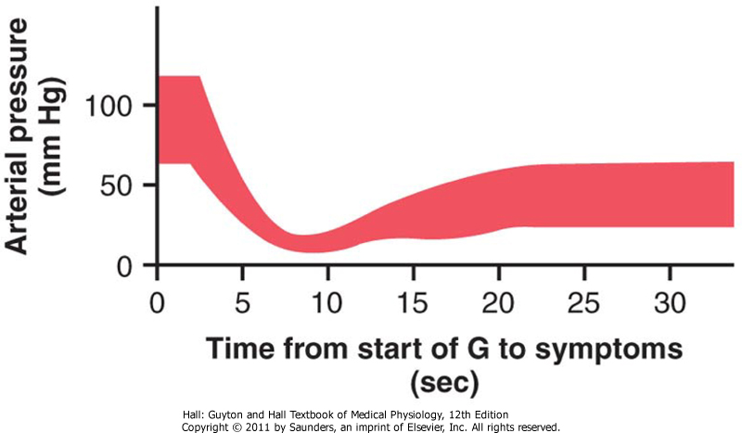

Slide 29
+3,3 G
baroreceptori

Slide 30
more than +20G – vertebral fracture
outside loops: from -4 to -5G
intense momentary hyperemia of the head, occasionally brain edema
at –20G pressure increases to 300-400 mm Hg – rupture of small vessels in the brain (cerebrospinal fluid cushioning buffer)
eyes become blinded with "red-out"

Slide 31
Protection of Pilots
tightening of abdominal muscles and leaning forward to compress the abdomen
anti-G suits
pilot submerged in a tank or suit of water?
the limit of safety almost certainly would still be less than 10 G

Slide 32
Linear Acceleratory Forces Effects
blast-off acceleration
9G, 8G i 3G
semireclining position transverse to the axis of acceleration
forces continue for several minutes
mach 100 would require a distance of about 10,000 miles for safe deceleration

Slide 33
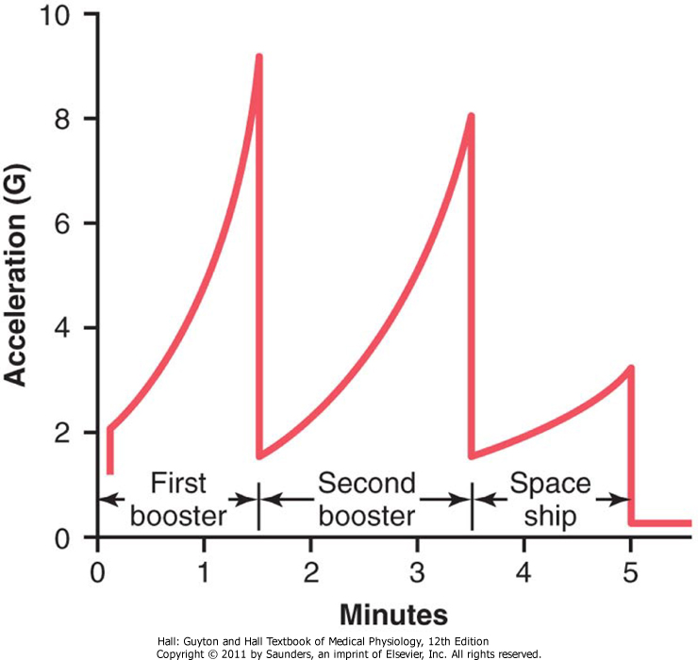

Slide 34
Parachute Jumps
1 s ⇨ v = 9,8 m/s (32 feet per second)
2 s ⇨ v = 19,6 m/s (64 feet per second)
after falling for about 12 seconds, the person will be falling at a "terminal velocity" of 109 to 119 miles per hour (50 m/s or180 km/h)

Slide 35
"opening shock load" of up to 1200 pounds (5400N) can occur on the parachute shrouds
parachute slows the fall to 1/9 (6 m/s) about the terminal velocity
force of impact with the earth is about the same as that which would be experienced by jumping without a parachute from a height of about 6 feet – fractures

Slide 36
"Artificial Climate"
earlier – pure oxygen at about 260 mm Hg (35 kPa) pressure was used
in the modern space shuttle – four times as much nitrogen as oxygen and a total pressure of 760 mm Hg
explosion and atelectasis

Slide 37
"Artificial Climate"
recycling techniques (electrolysis of water) and generation (use of algae)
weightlessness, state of near-zero G force, or microgravity – gravity acts on both the spacecraft and the person at the same time so that both are pulled with exactly the same acceleratory forces and in the same direction

Slide 38
Physiologic Problems
motion sickness during the first few days of travel (nausea, vomiting) – 50%, 2-5 days
translocation of fluids
diminished physical activity – may lose 1% of their bone mass each month
"artificial gravity“ – short-arm centrifuges

Slide 39
Physiology of Deep-Sea Diving

Slide 40
exposes the blood in the lungs to extremely high alveolar gas pressure – hyperbarism
depth & pressure
101,325 kPa = 1 atm
101,325 kPa = 1.013 bara

Slide 41
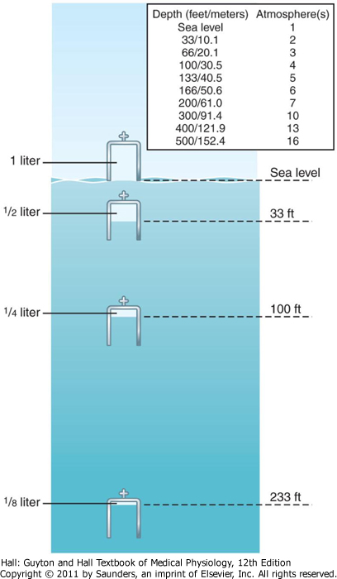
Boyle’s low

Slide 42
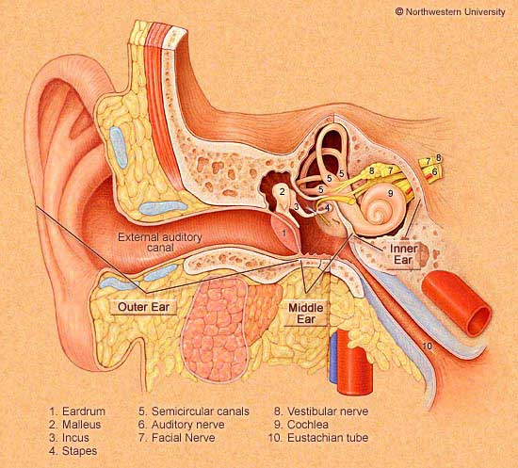

Slide 43
Nitrogen Narcosis
4/5 air = N₂
at high pressures – varying degrees of narcosis
“raptures of the depths” – limiting factor while diving using compressed air
mechanism of the narcotic effect is believed to be the same as that of most other gas anesthetics???

Slide 44
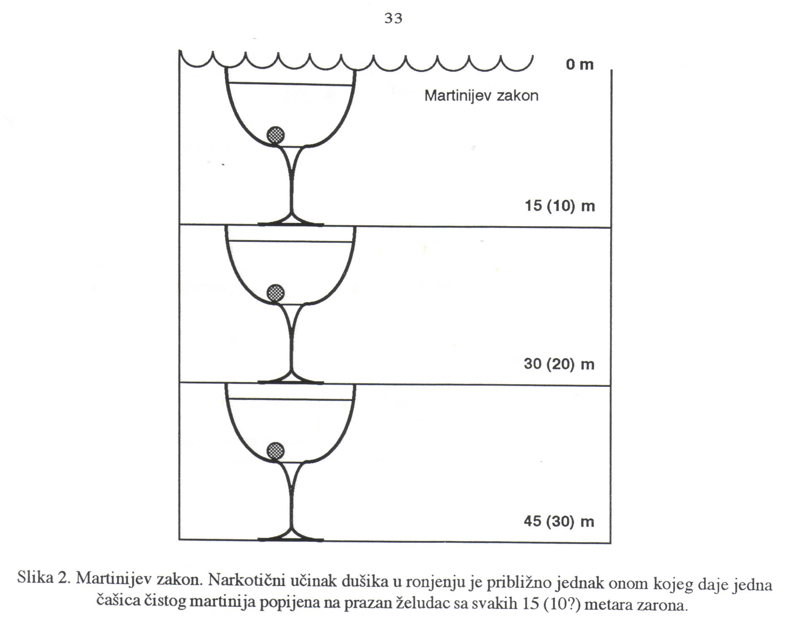

Slide 45
Effect of Very High Po₂ on Blood Oxygen Transport
above P_{O2} of 100 mmHg ⇨  dissolved oxygen in the water of the blood
normal tissue P_{O2} 20-60 mmHg (2,7-8,0 kPa)

Slide 46
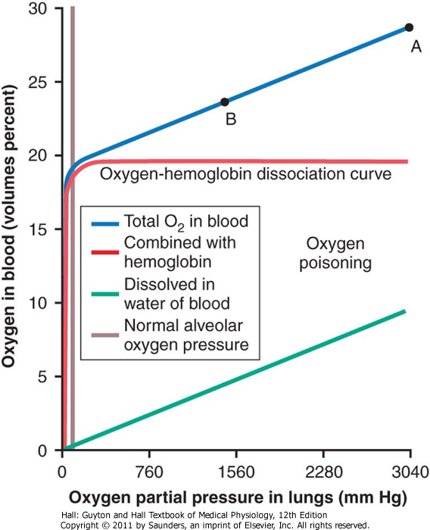

Slide 48
Acute Oxygen Poisoning
brain is extremely sensitive to high P_{O2}
P_{O2} of 3040 mmHg (400 kPa) – seizures followed by coma (30-60 min)
seizures often occur without warning
nausea, muscle twitching, dizziness, disturbances of vision, irritability, and disorientation
exercise greatly increases oxygen toxicity

Slide 49
Oxidizing Free Radicals
superoxide free radical: O₂⁻, peroxide
even at Po₂ of 40 mmHg, small amounts of free radicals are continually being formed
enzymes for removal (peroxidases, catalases, and superoxide dismutases)
critical alveolar Po₂ – 2 Atm (200 kPa)
oxidation of the polyunsaturated fatty acids and enzymes

Slide 50
Chronic Oxygen Poisoning
exposition to only 1 atmosphere pressure (100 kPa) of oxygen for 12 hours
lung disorders: lung passageway congestion, pulmonary edema, and atelectasis (damage to the linings of the bronchi and alveoli)

Slide 51
Carbon Dioxide Toxicity
in normal conditions – NO
carbon dioxide can build up in the dead space
diver usually tolerates this buildup up to P_{CO2} of 80 mmHg (10,7 kPa) ?
beyond P_{CO2} of 80 mmHg – depression of respiratory center, severe respiratory acidosis, lethargy, narcosis and anesthesia

Slide 52
Decompression of the Diver
removal of N₂ often takes hours to occur – multiple problems collectively called decompression sickness
at sea level, almost exactly 1L of N₂ is dissolved in the body (water & fat by 50%)
at 30 m 4L & at 90 m 10L, but after several hours

Slide 53
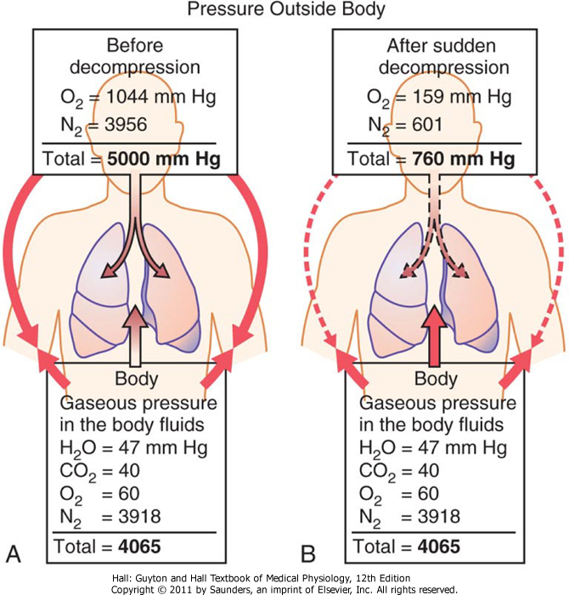

Slide 54
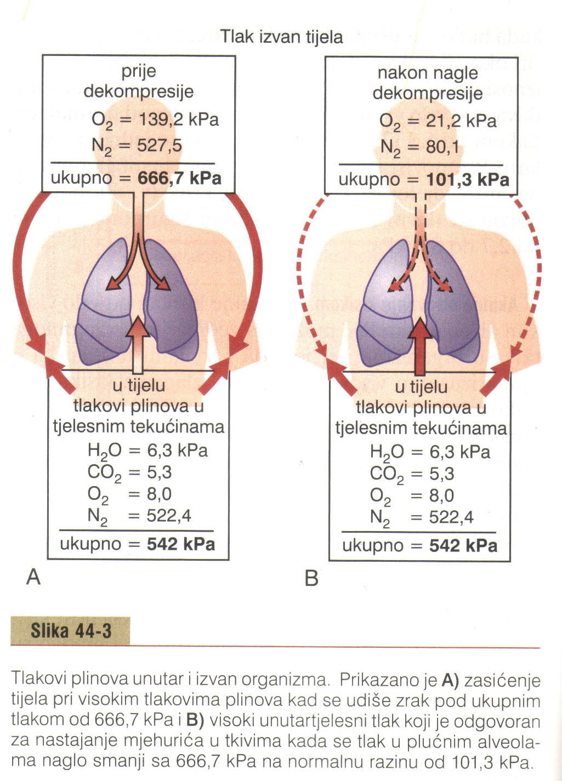

Slide 55
Decompression Sickness
bends, compressed air sickness, caisson disease, diver's paralysis, dysbarism
pluging of small vessels, ischemia, necrosis
two types
pain in the joints and muscles of the legs and arms (85%)
decompression tables (US Navy) – slow surfacing (3 x longer that bottom time)

Slide 56
tank (chamber) decompression
more important for treating people
“saturation diving”
nitrogen is replaced by helium:
1/5 of the narcotic effect of nitrogen
½ volume dissolves, rapid removal
low density (1/7, breathing resistance)
1% O₂ mixture at 210 m (700 feet) enough

Slide 57
SCUBA ronjenje
Jacques Cousteau 1943.
99% open-circuit demand system
limited amount of time one can remain beneath the sea surface

Slide 58
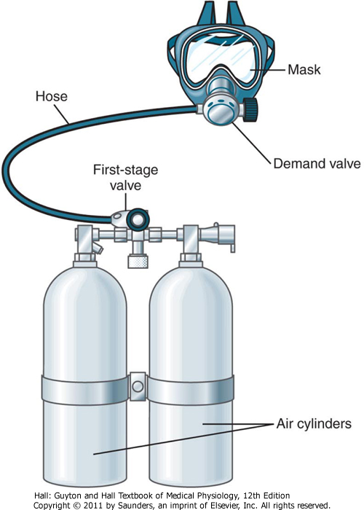

Slide 59
Physiologic Problems in Submarines
escape is possible from as deep as 300 feet (90 m) without using any apparatus
prevention of air embolism
problem of radiation hazards
CO (cigarette smoking), Freon gas

Slide 60
Hyperbaric Oxygen Therapy
hyperbaric oxygen
P_{O2} at 2 to 3 Atm (200-300 kPa)
gas gangrene, arterial gas embolism, carbon monoxide poisoning, osteomyelitis, and myocardial infarction

Slide 61
